Slide 1
Genomics of Drosophila melanogaster populations experimentally evolved for postponed reproduction
Giovanni A. Crestani​

Slide 2
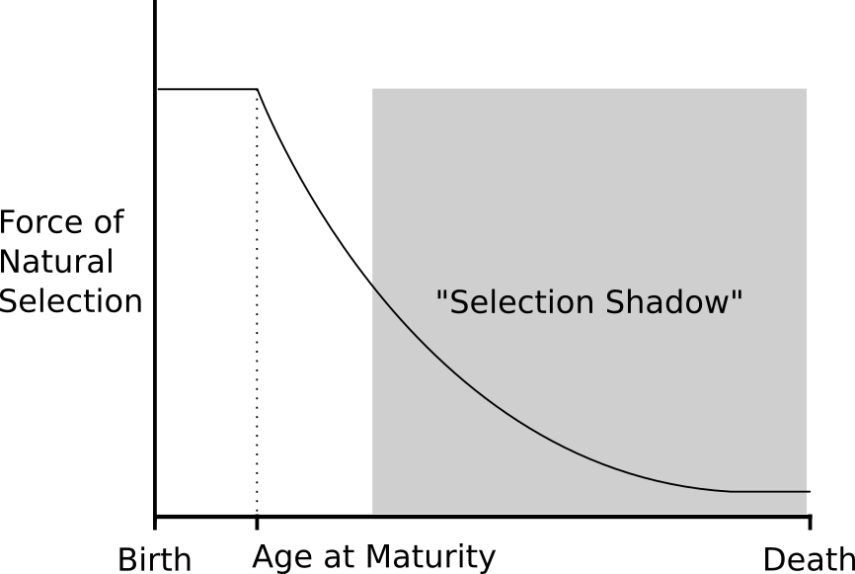
Evolutionary Theory of Aging
Hamilton, 1966
Medawar, 1958
Adapted from: Fabian, D. & Flatt, T. (2011) The Evolution of Aging. Nature Education Knowledge 3(10):9
Notes:
(Hamilton, 1966; Medawar, 1958; Williams, 1957)

Slide 3
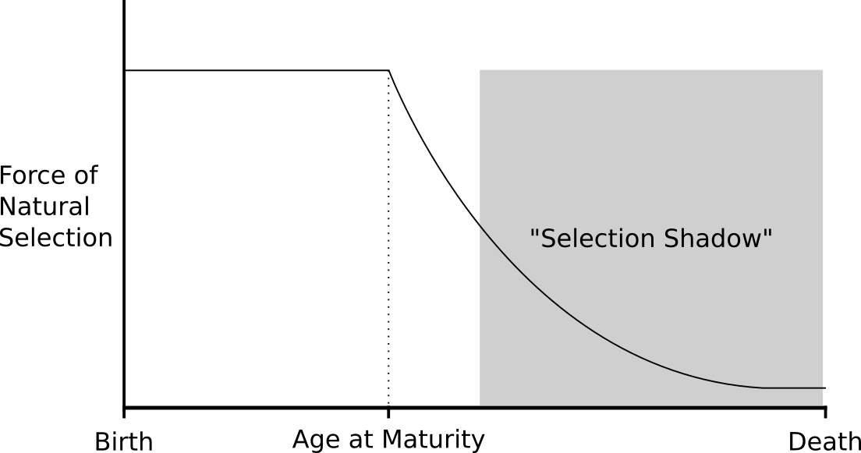
Adapted from: Fabian, D. & Flatt, T. (2011) The Evolution of Aging. Nature Education Knowledge 3(10):9

Slide 4
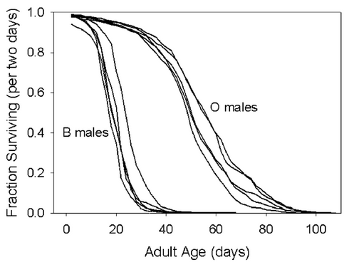
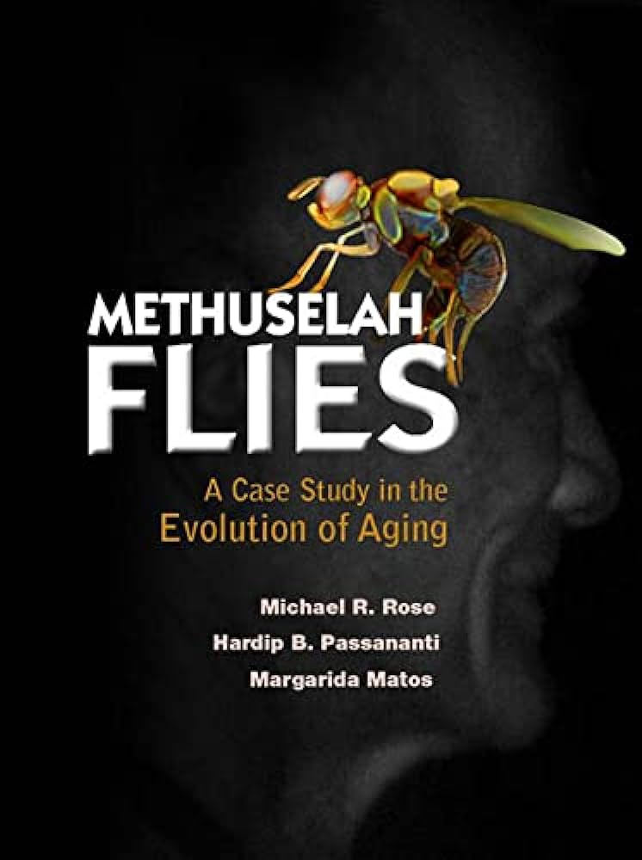

Dr. Michael Rose’s Methuselah Flies
Drosophila melanogaster populations selected for postponed fertility
Rose et al. 2002 Evolution – First results in 1984

Slide 5
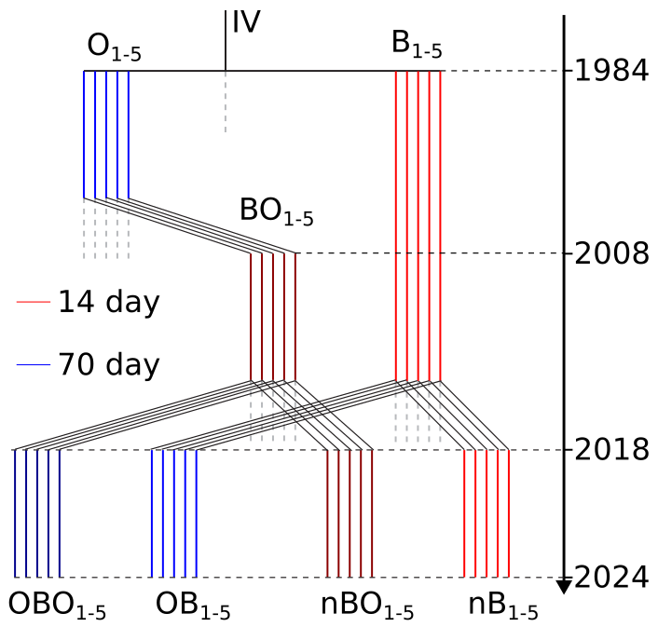
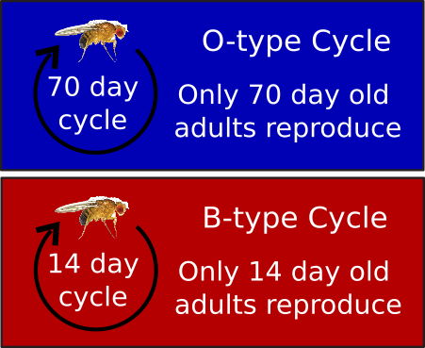
OBO = Old + BO
OB = Old + B
nBO = new + BO
nB = new + B

Slide 6

Phenotype Assays
Age-specific survival and longevity
Immune defense
Fecundity
Development time
Starvation resistance
Desiccation resistance
Body weight

Slide 7
Phenotype Assays
Age-specific survival and longevity
Immune defense
Fecundity
Development time
Starvation resistance
Desiccation resistance
Body weight

Slide 8
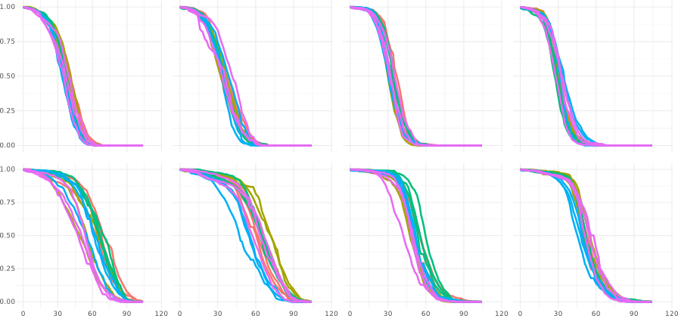
Age-specific survival & Longevity (O-type gen. 17)
BO
B
BO
B
nBO (♀)
nB (♀)
nBO (♂)
nB (♂)
B-type
Survival Rate
OBO (♀)
OB (♀)
OBO (♂)
OB (♂)
O-type
♀
Age (days)
♂

Slide 9
Phenotype Assays
Age-specific survival and longevity
Immune defense
Fecundity
Development time
Starvation resistance
Desiccation resistance
Body weight
O-type flies show higher levels on all the phenotypes analysed.

Slide 10
Aims
Aim 1: Selection regimen VS Ancestry - which one defines you?
Aim 2: Genomic regions associated with the phenotypes

Slide 11
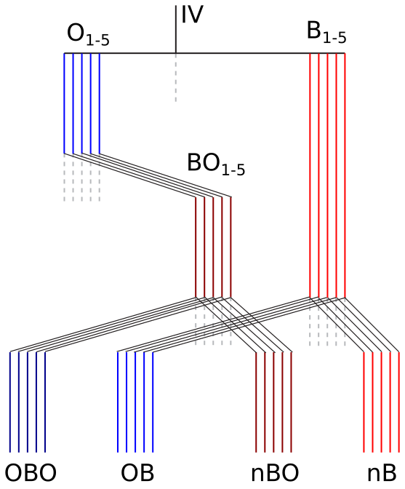
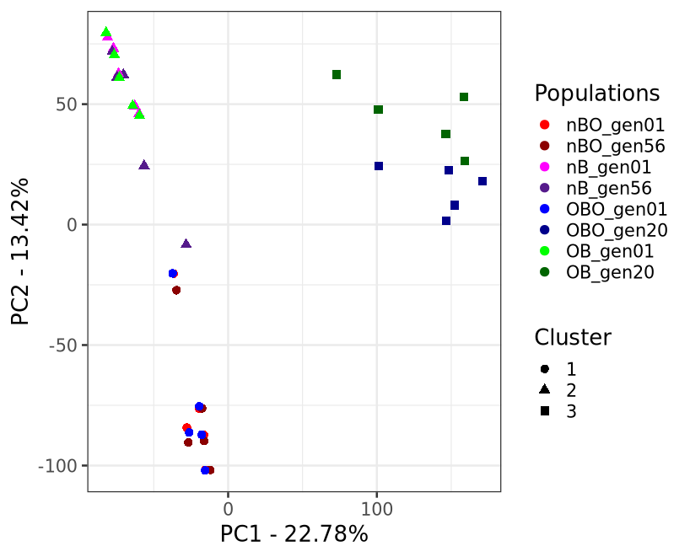
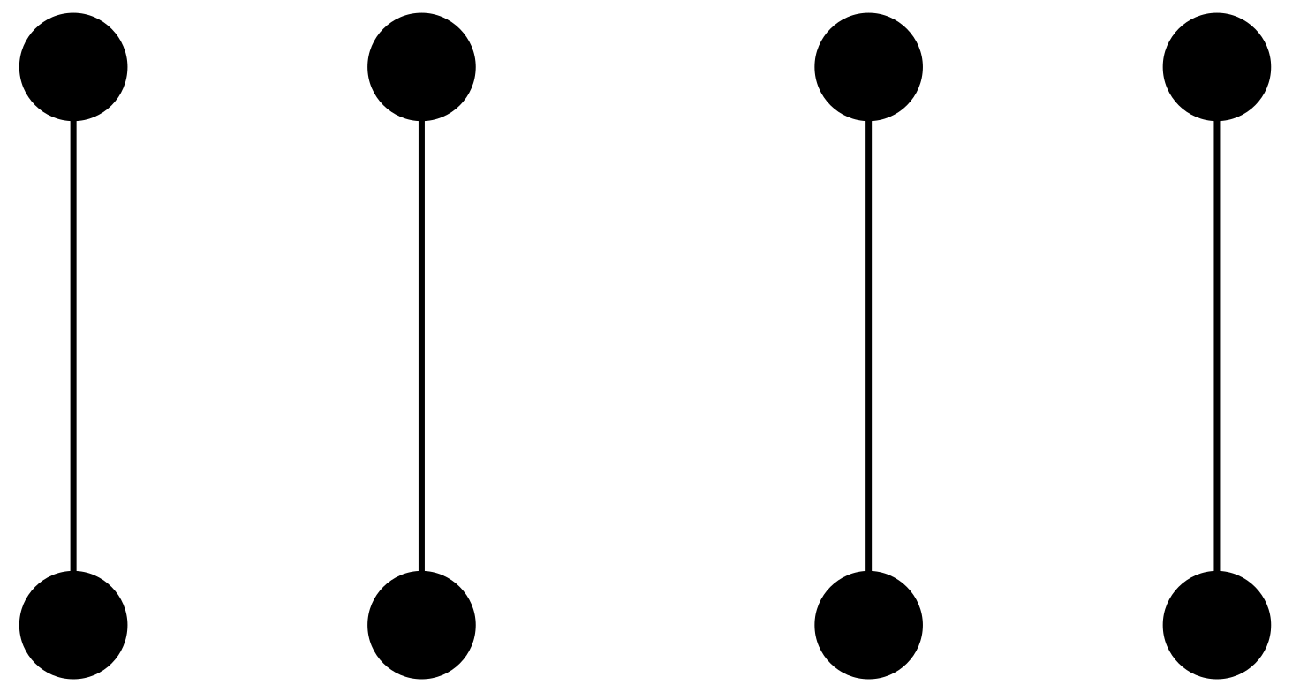

Aim 1
Gen 1
Gen 20/56

Slide 12
Aim 1
Gen 1
Gen 20/56

Slide 13
Aim 1
Gen 1
Gen 20/56

Slide 14
Aim 1
Gen 1
Gen 20/56

Slide 15
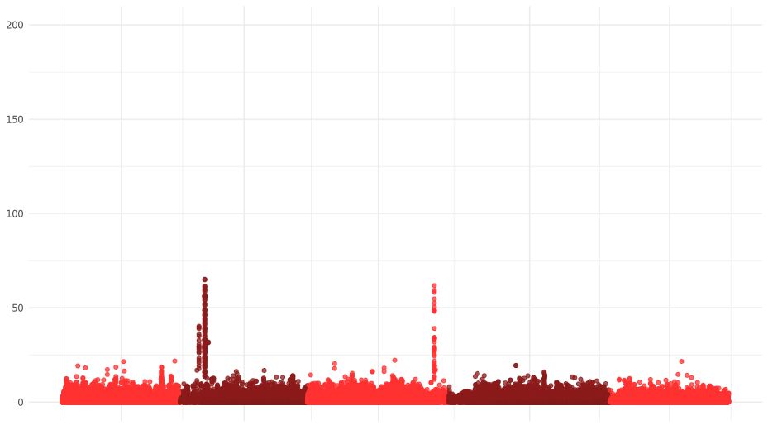
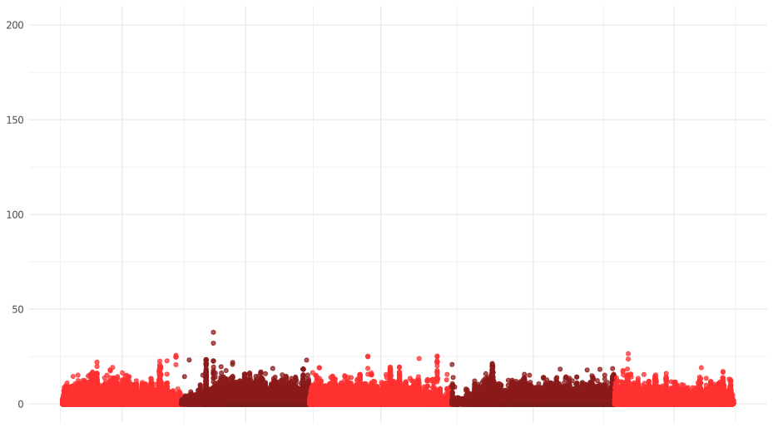
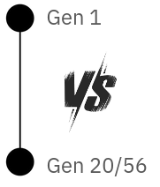
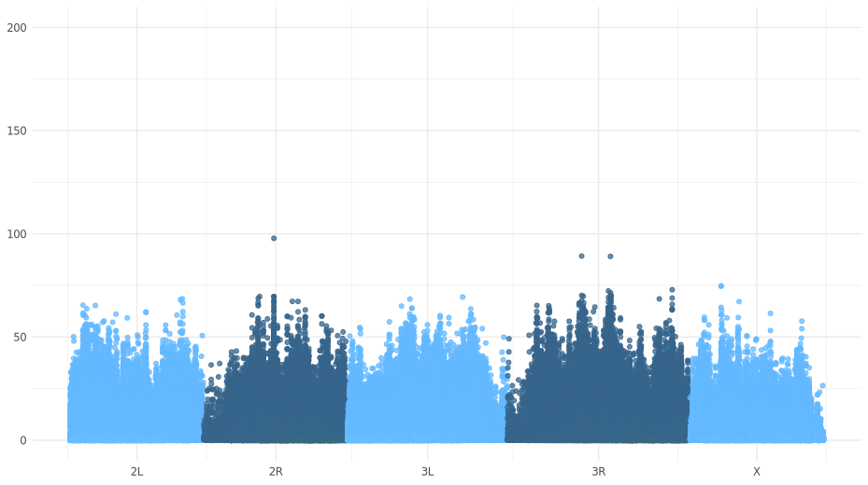
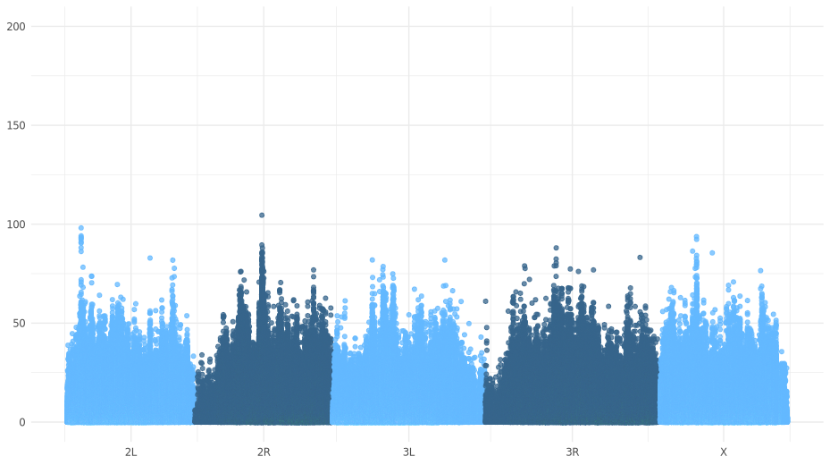
Aim 1
nBO gen01 vs nBO gen56
nB gen 01 vs nB gen 56
-log10(adjusted p-value)
OBO gen 01 vs OBO gen 20
OB gen 01 vs OB gen 20
Genomic Position

Slide 16
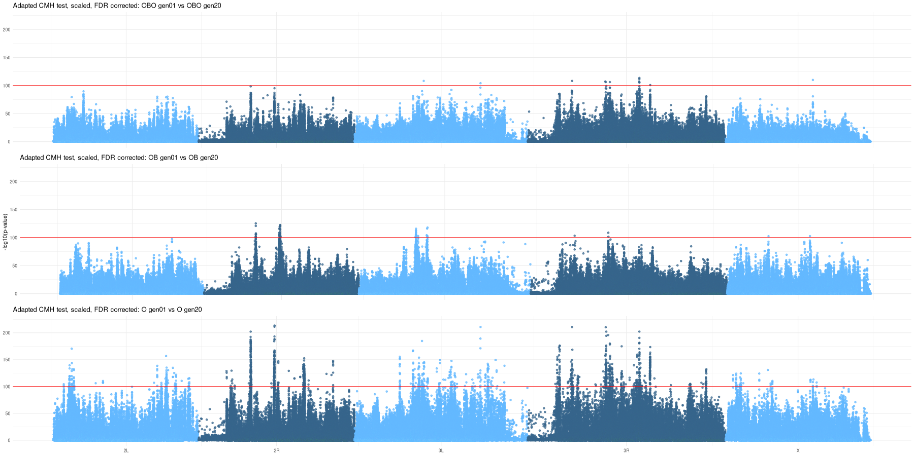
Aim 2
OBO₁₋₅ gen01 vs OBO₁₋₅ gen20
OB₁₋₅ gen01 vs OB₁₋₅ gen20
O₁₋₁₀ gen01 vs O₁₋₁₀ gen20

Slide 17
Aim 2
OBO₁₋₅ gen01 vs OBO₁₋₅ gen20
1294 SNPs, 300 genes
OB₁₋₅ gen01 vs OB₁₋₅ gen20
O₁₋₁₀ gen01 vs O₁₋₁₀ gen20

Slide 18
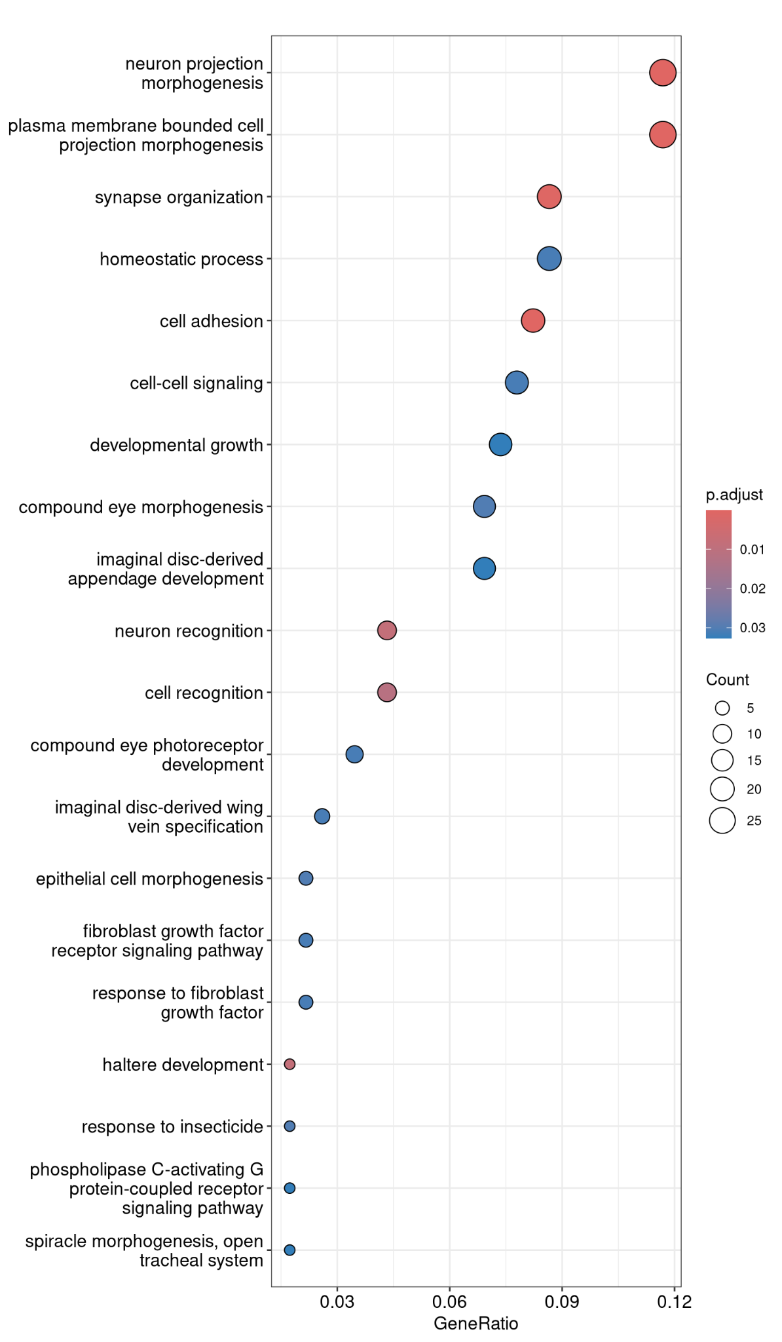

Gene Ontology (GO) Enrichment Analysis
Are there any specific GO terms overrepresented in these 300 genes?
What Biological Functions are associated with these genes?
Overall stress-resistance terms
Neuron-related terms are commonly enriched, not necessarily biologically-relevant

Slide 19
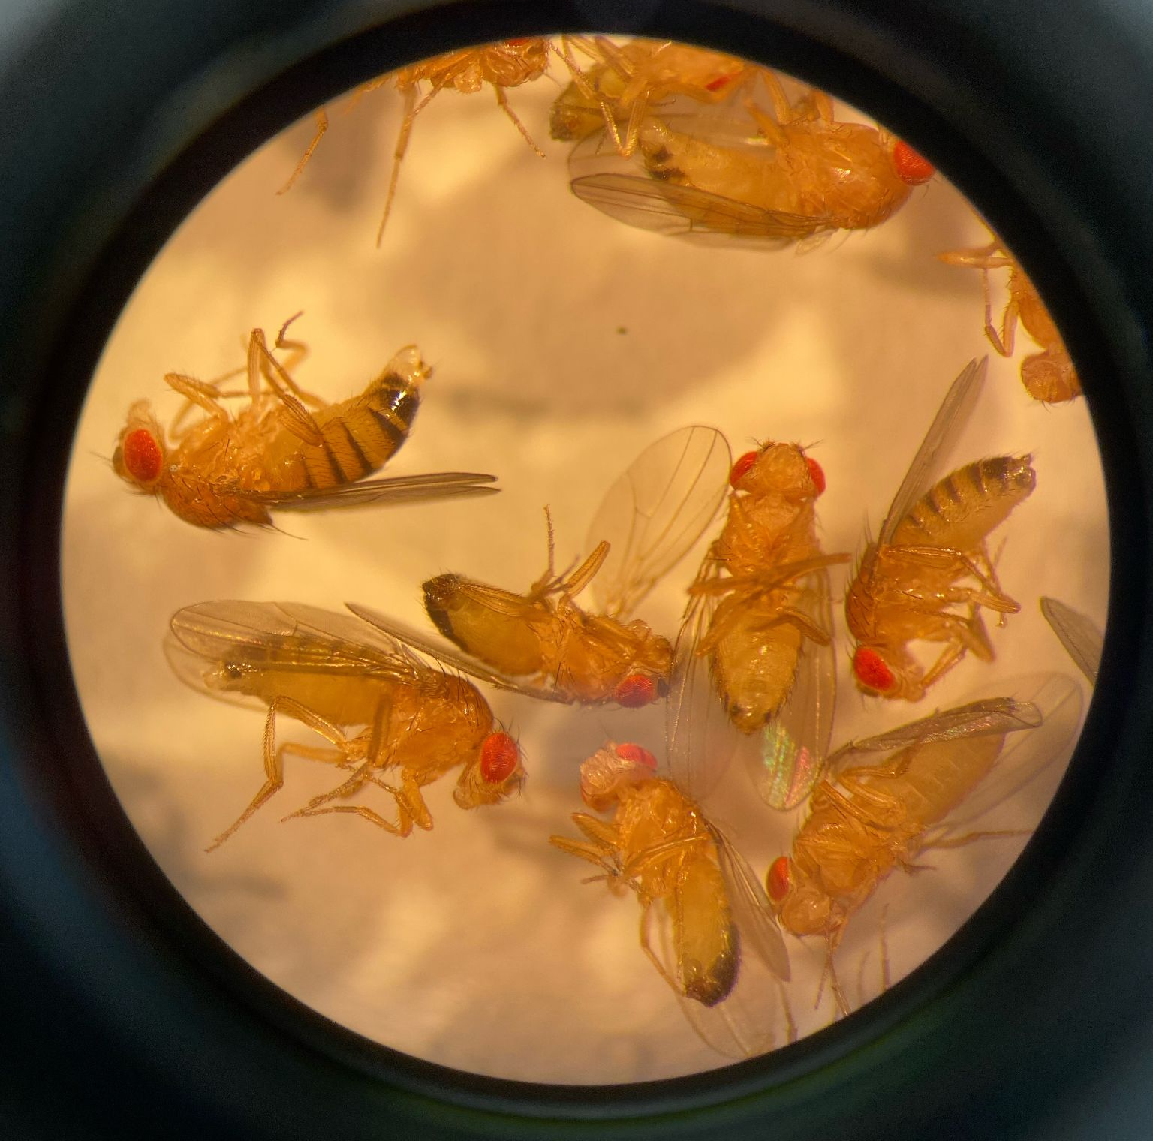
Thank you!
Questions?
Giovanni A. Crestani
crestang@oregonstate.edu
gacrestani.com/

Slide 20
Supplementary Slides

Slide 21
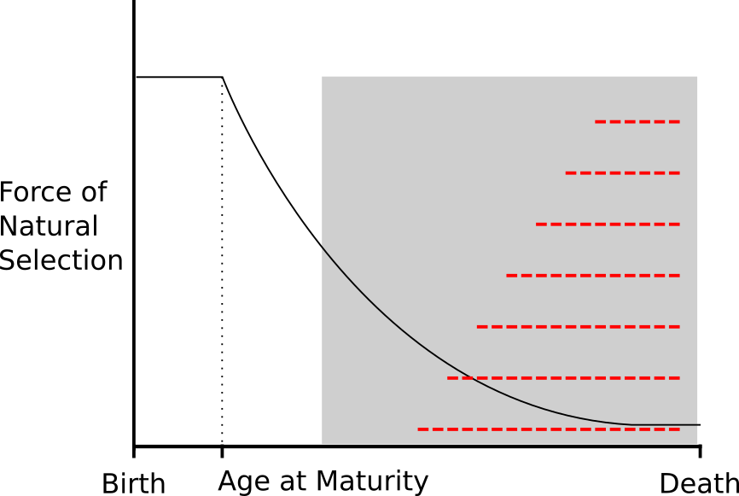
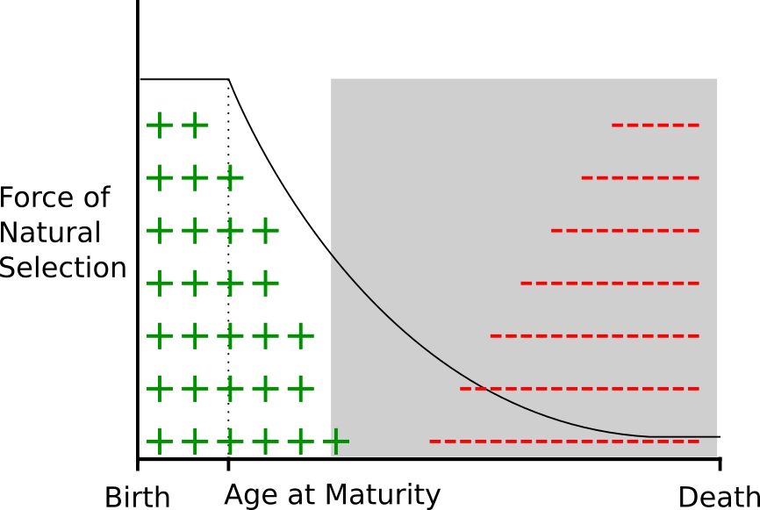
Intro
Mutation Accumulation
Antagonistic Pleiotropy
Adapted from: Fabian, D. & Flatt, T. (2011) The Evolution of Aging. Nature Education Knowledge 3(10):9

Slide 22
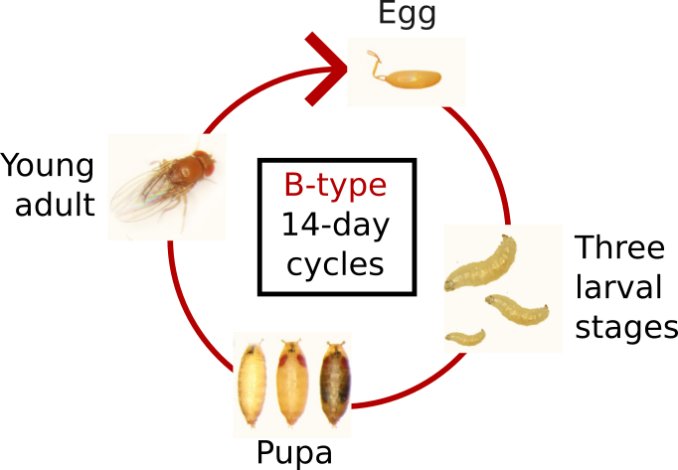
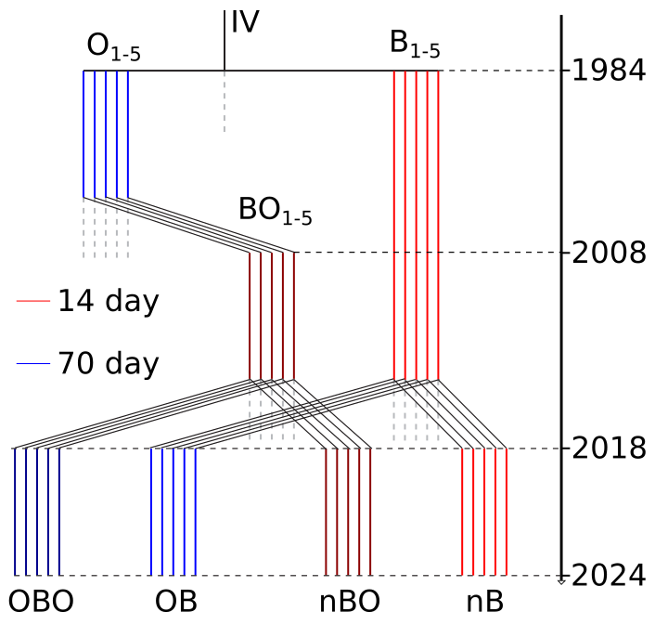
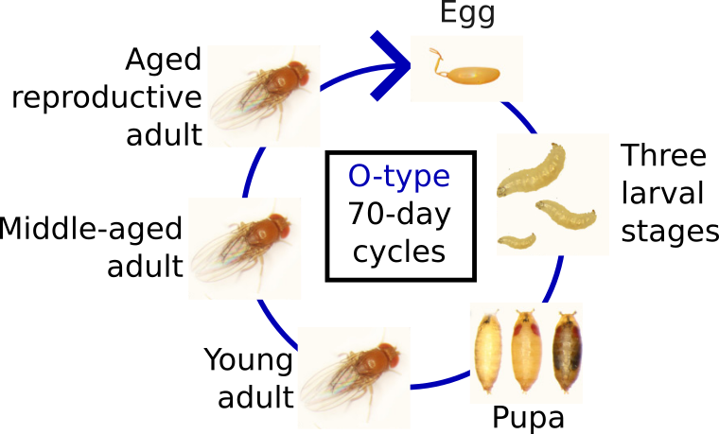
Intro

Slide 23
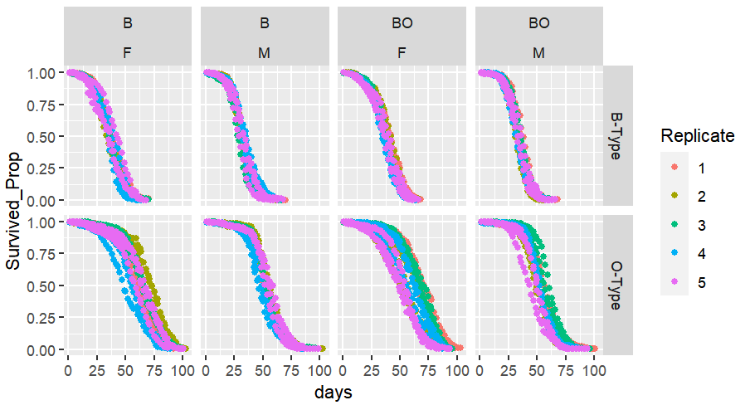
Survival Curves (gen 20)

Slide 24
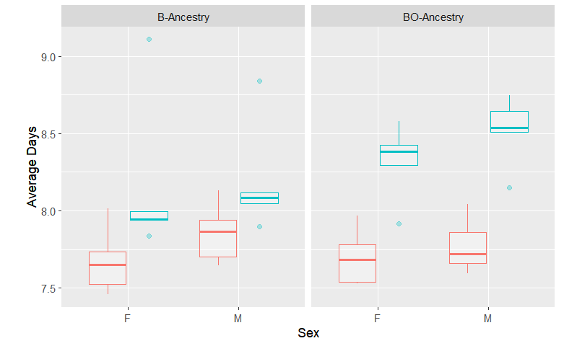
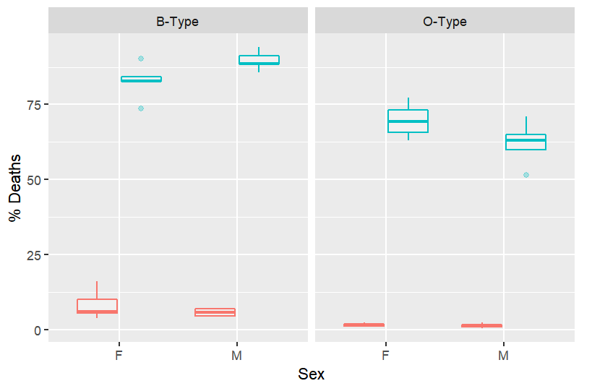
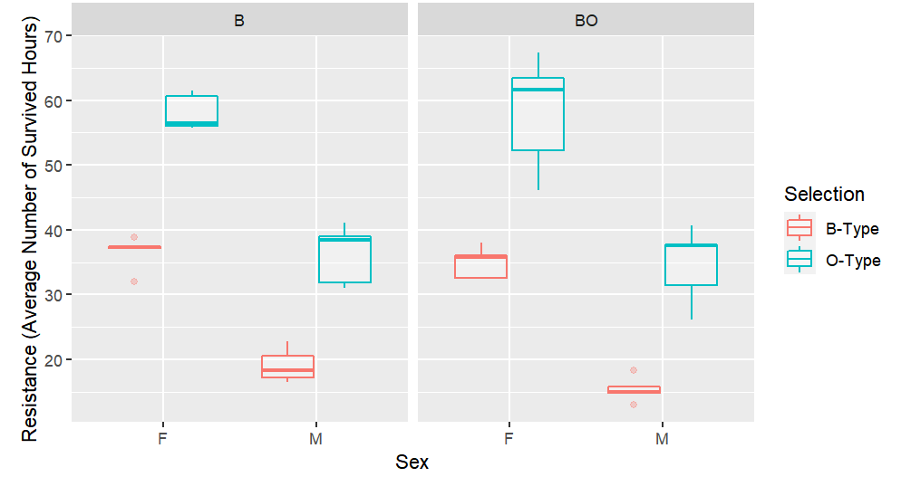
Other Phenotypes
Development Time
Immune Defense

Slide 25
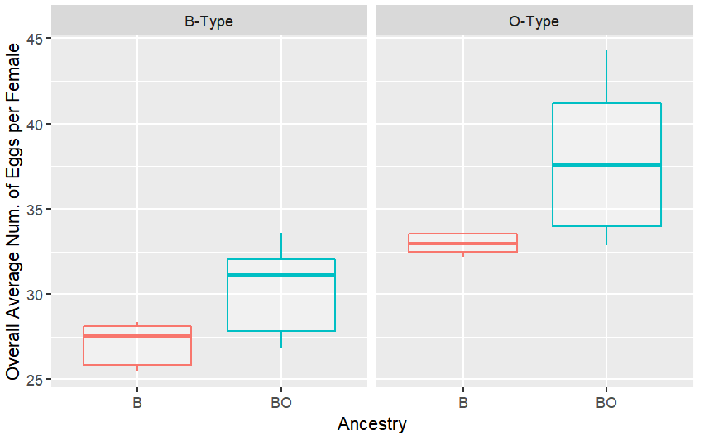
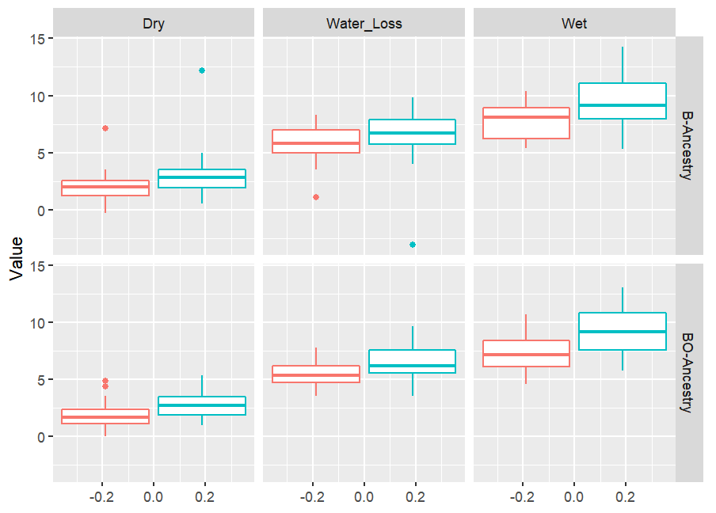
Other Phenotypes
Fecundity
Body Weight

Slide 26
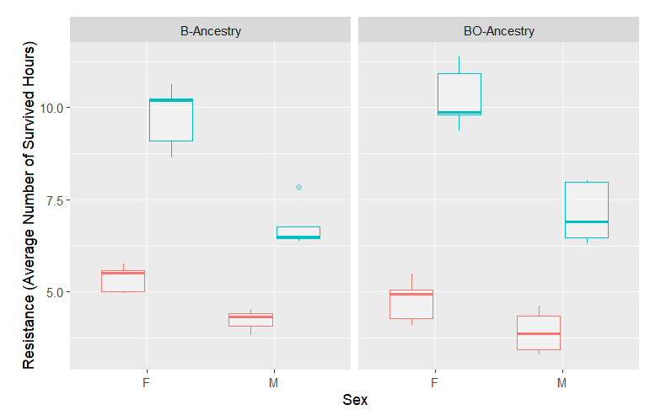
Other Phenotypes
Desiccation Resistance
Starvation Resistance

Slide 27
Methods (Analysis)
Aim 1
Chapter 1
Cochran–Mantel–Haenszel (CMH) test
 | Minor Allele Count | Total Counts
Sample 01 | 12 | 36
Sample 02 | 7 | 28
 | Minor Allele Count | Total Counts
Sample 01 | 12 | 36
Sample 02 | 7 | 28
 | Minor Allele Count | Total Counts
Sample 01 | 12 | 36
Sample 02 | 7 | 28
 | Minor Allele Count | Total Counts
Sample 01 | 12 | 36
Sample 02 | 7 | 28
 | Minor Allele Count | Total Counts
Sample 01 | 12 | 36
Sample 02 | 7 | 28
 | Minor Allele Count | Total Counts
Sample 01 | 12 | 36
Sample 02 | 7 | 28
 | Minor Allele Count | Total Counts
Sample 01 | 14 | 39
Sample 02 | 7 | 25
5 replicates

Slide 28
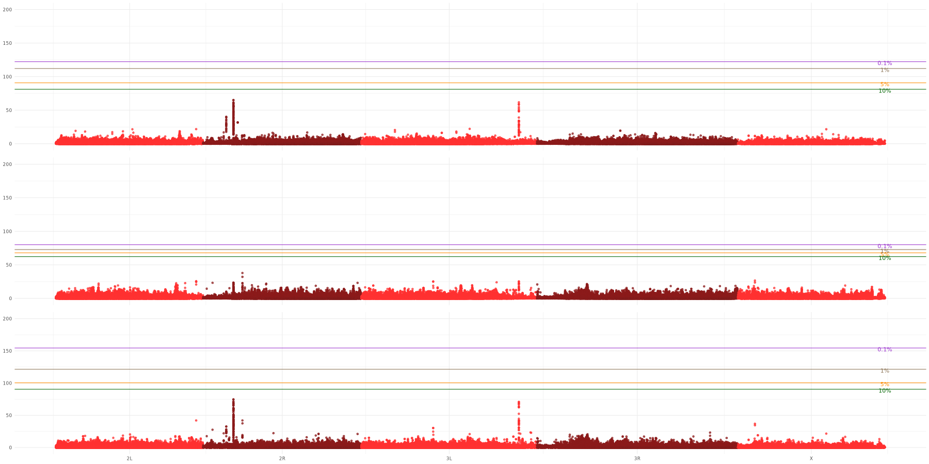
Aim 2
Chapter 1
nBO₁₋₅ gen01 vs nBO₁₋₅ gen56
nB₁₋₅ gen01 vs nB₁₋₅ gen56
B₁₋₁₀ gen01 vs B₁₋₁₀ gen56

Slide 29
